Slide 1


0
“ArduSecure- Laser Based Intrusion Detection & SMS Alert System Using Arduino”
PROJECT VIVA PRESENTATION SEM :- V DEPARTMENT OF COMPUTER ENGINEERING
 |  | PRESENTED BY:- Mr. Keshav Joshi
YADAVRAO TASGAONKAR INSTITUTE OF ENGINEERING AND TECHNOLOGY, KARJAT

Slide 2
INDEX
Abstract
Introduction
Scope of research work
Objective
Literature Review
Problem & Definition
Proposed System
Flowchart / Design
Application
References

Slide 3
ABSTRACT
ArduSecure is a smart laser-based intrusion detection system developed using Arduino.
It combines optical sensing (Laser–LDR) with wireless communication (GSM) to detect and report intrusions.
When an intruder interrupts the laser beam, the Arduino Uno processes the change in LDR output.
The system immediately activates a buzzer/alarm for local notification.
Simultaneously, a GSM module transmits an SMS alert to the owner’s mobile phone.
Software implementation uses Arduino IDE with AT Commands for GSM communication.
The system is low-cost, reliable, and real-time, offering scalability for IoT-based enhancements.
Applications include home security, offices, shops, banks, warehouses, and restricted zones.

Slide 4
INTRODUCTION
Security is a major concern in homes, offices, and restricted areas.
Traditional security systems often require constant monitoring and can be expensive.
ArduSecure is a smart and cost-effective solution for real-time intrusion detection.
Uses a Laser–LDR pair to sense unauthorized entry.
Arduino Uno acts as the central controller to process sensor data.
Integrates a GSM module to send instant SMS alerts to the owner.
Local alarm (buzzer) provides immediate on-site notification.
Can be applied in homes, offices, banks, warehouses, and restricted zones.

Slide 5
Scope of research work
Expandable to IoT-based remote monitoring.
Customizable detection sensitivity and alert messages.
Low-cost, real-time security solution for homes, offices, and restricted areas.
Can be integrated with multiple zones or additional sensors for enhanced security.

Slide 6
OBJECTIVES
Develop a real-time intrusion detection system using Arduino.
Detect unauthorized entry using a Laser–LDR mechanism.
Provide instant alerts through a buzzer/alarm for local notification.
Send SMS alerts to the owner via GSM module.
Design a low-cost, reliable, and easy-to-implement security system.
Enable scalability for multiple zones or IoT integration.

Slide 7
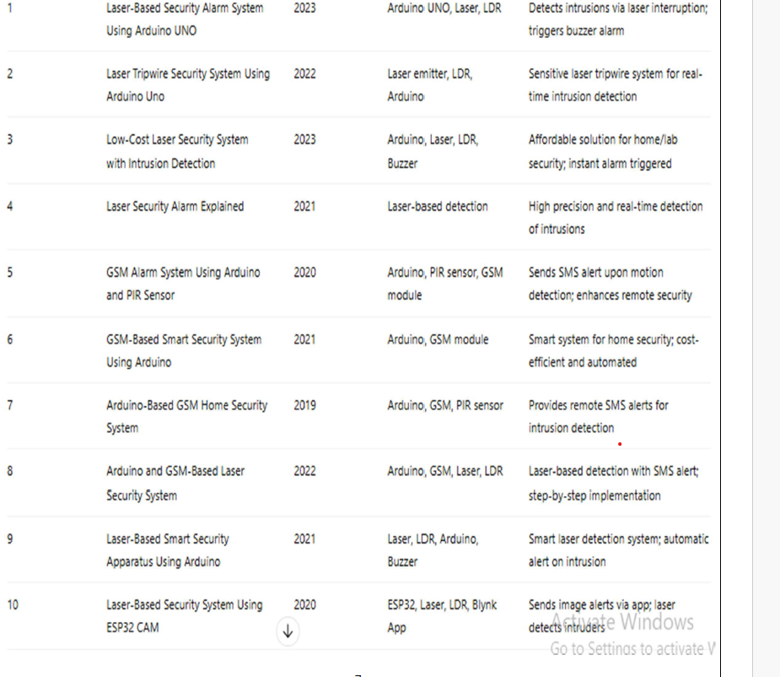
LITERATURE REVIEW

Slide 8
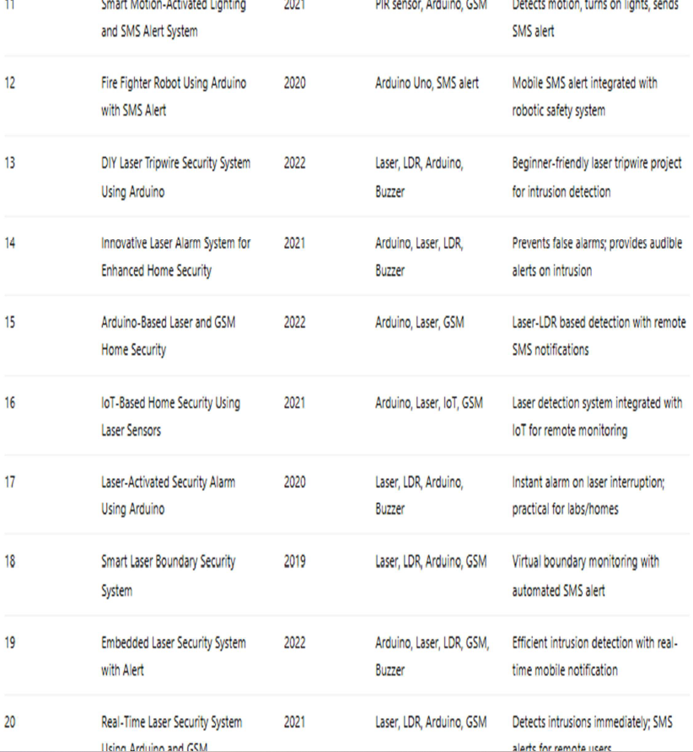

Slide 9
PROBLEM & DEFINITION
Problem:
Increasing need for real-time security in homes, offices, and restricted areas.
Traditional systems (CCTV, manual monitoring) are expensive and require constant supervision.
Existing solutions often lack instant alerts and multi-zone scalability.
Definition:
ArduSecure is a low-cost, real-time intrusion detection system.
Uses a Laser–LDR mechanism to sense unauthorized entry.
Arduino Uno processes sensor input and triggers alerts.
Integrates buzzer for local alarm and GSM module for SMS notification.
Designed to be reliable, easy to implement, and scalable for various security applications.

Slide 10
PROPOSED SYSTEM
ArduSecure is a laser-based intrusion detection system using Arduino.
Laser–LDR pair detects any interruption caused by an intruder.
Arduino Uno processes the sensor signal in real-time.
Buzzer/Alarm provides immediate local notification.
GSM Module sends an SMS alert to the owner’s mobile phone.
System is low-cost, reliable, and scalable for multiple zones or IoT integration.
Designed for homes, offices, warehouses, and restricted areas.

Slide 11
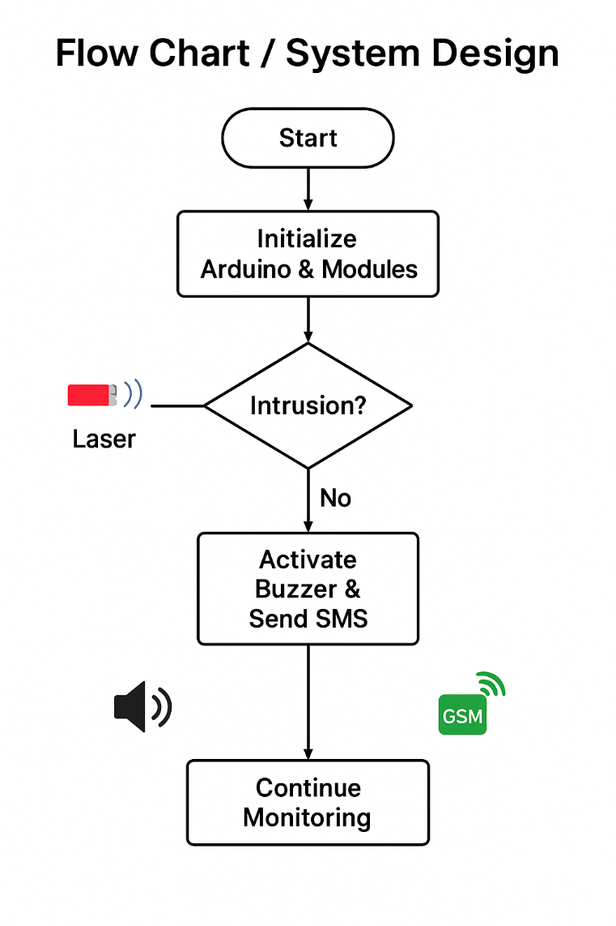
FLOW CHART / DESIGN

Slide 12
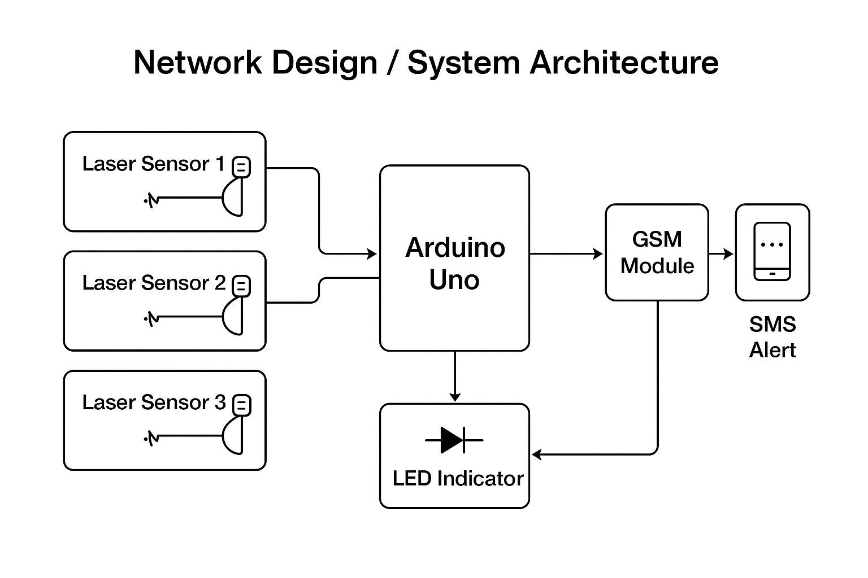
NETWORK DESIGN

Slide 13
APPLICATION
School classroom monitoring
Temple crowd control
Cold storage security for farmers
Home security
Office and laboratory safety
Warehouse and factory monitoring
Parking area management
Museum and exhibition protection

Slide 14
REFERENCES
Author & Year | Dataset / Method | Result / Contribution | Limitation | Strength
Kumar & Singh, 2021 | Arduino + LDR + GSM | Real-time laser-based intrusion detection with SMS | Limited range of detection | Low-cost, easy implementation
Patel et al., 2020 | IR & Laser Sensors | Improved intrusion detection for small premises | Affected by light conditions | Reliable short-distance detection
Sharma & Gupta, 2019 | Arduino UNO + GSM Shield | SMS notification system for home security | No video evidence captured | Quick SMS response
Ahmed et al., 2018 | Laser-LDR Circuit | Detection accuracy of 95% in lab setup | Sensitive to alignment | High accuracy at single point
Verma et al., 2022 | IoT with Wi-Fi Module | Online monitoring via mobile app | Needs internet connectivity | Remote accessibility
Reddy et al., 2017 | GSM & PIR Sensor | Intrusion detection with motion sensing | PIR false triggers | Combines motion + alert
Khan & Ali, 2016 | Laser + Microcontroller | Continuous monitoring system | Single-node architecture | Robust beam interruption detection
Bhattacharya, 2021 | Arduino + Buzzer Alarm | Local alert-only security | No remote alert | Fast local warning

Slide 15
Author & Year | Dataset / Method | Result / Contribution | Limitation | Strength
Roy et al., 2019 | GSM-based Arduino System | SMS alert for intrusion in schools | Cannot scale to campuses | Cost-effective for small areas
Jain & Kaur, 2020 | IoT & GSM Hybrid | Integrated IoT monitoring with SMS fallback | Needs Wi-Fi + GSM hardware | Redundant alert system
Thomas & Raj, 2018 | Arduino with Sensors | Secure premises monitoring | No cloud storage | Easy DIY security system
Choudhary et al., 2017 | Multi-sensor Security | Intrusion detection with multiple LDR sensors | Higher complexity | Reliable multi-point coverage
Singh et al., 2021 | GSM + Arduino + IoT Cloud | SMS + cloud-based data storage | Internet dependent | Real-time & stored evidence
Pandey et al., 2022 | Arduino Mega + GSM | Large-scale area surveillance | Higher cost hardware | Supports multiple sensors
Alvi et al., 2016 | GSM Alert System | SMS-based intrusion alert in rural areas | Limited to GSM network | Works without internet

